Slide 1
Predicting Song Views & Virality on YouTube
Harrison Cradduck, Marah Donahoe,
Joey Endres, & William Knapp

Slide 2
Agenda
1
Problem
2
Data Collection, Preparation, & Analysis
3
Modeling
4
Conclusions

Slide 3
Abstract
Song virality and view count are often difficult to predict, as there are many variables involved. By running a random forest model, we found that only 17% of the variability in music video view count is attributed to song metrics, artist information, and lyric sentiment. Other metrics related to music videos themselves, social media algorithms, and cultural factors likely explain the missing variation. Additionally, running a random forest model on song virality resulted in an AUC of 0.756 and F1 of 0.62, promising indicators of model success. Proposed recommendations and solutions based on the project results include collaborating with experienced artists, producing songs of most popular genres (pop, reggae), and increasing volume, beat, and repetitiveness.

Slide 4
Introduction

Slide 5
Why do songs go viral?
Artists constantly look for unique ways to create viral music
Any number of attributes could play a part in making a song a “hit”
  Tempo, Key, Sentiment, Beat, Social Media Algorithms, etc.
This information will benefit producers and artists
  Assist in choosing artists & songs that reach production
  Support creative decisions in production

Slide 6
Value in Analytics
Predicting Youtube video view count for a song (in English)
Spotify Audio Features
Lyrical Sentiment/Topics
Artist Attributes
Using both Classification & Regression Modeling
Leading to the Creation of Hit Songs

Slide 7
Outcome
Classification: Random Forest
Accuracy: 65%
F1: 0.62
AUC: 0.756
Threshold: 0.31

Slide 8
Data Collection, Preparation & Analysis

Slide 9
Data Collection

Slide 10
What Data do we need?
Unique combinations of titles and artists for known songs
Lyrical data for text mining analysis
  Seek to draw predictive power from words
  Previous studies/models have not considered lyrical, unstructured data
Artist history and industry nature at the time of release
YouTube popularity metrics
  Unique avenue / platform for song popularity prediction
  Previous studies/models focus on music-centered platform
Audio features
  Incorporates song facts and listener preference into analysis
Notes:
Really emphasize the importance of text mining and how it will help our analysis

Slide 11
Data Sources
Billboard.com/charts
Genius API
MusicBrainz API
Web-scraped using BeautifulSoup in Python
Song titles, artists, chart years
18,959 songs (unique combos of titles and artists)
Used Lyrics Genius library to pull song lyrics
Text mining - draw predictive power from words
13,873 songs with lyrics
5-hour runtime
Used MusicBrainz library to pull artist-related features
Name, type, genres, country, etc.
4,322 unique artists

Slide 12
Data Sources
YouTube
Kaggle
Web-scraped public YouTube metadata used yt-dlp package
View, like, and comment counts
15,002 songs with metrics
11-hour runtime
Merged 6 comprehensive Kaggle datasets with Spotify song audio features
Energy, key, acousticness, danceability, etc.
6,578 songs with audio features
Notes:
YouTube: attempted to utilize YouTube Data API v3, but met with 100 requests per day limit
YouTube: yt-dlp essentially creates a data collection API
Spotify: Spotify Web API endpoint for audio features was deprecated 11/2024

Slide 13
Data Preparation

Slide 14
Data Preparation
Categorize & dummy-code key, artist type and country
Correct inaccurate chart_year
Convert artist career begin_date to year
Zero imputation on comment_count
Median imputation on view_count & like_count
Convert chart_year to discrete
Mode imputation on artist type; collapse levels
Notes:
Inaccurate chart_year was an XXXTentacion song from 2022 labeled as 2029

Slide 15
Data Preparation
Split list of genres into elements & group into major categories
Rename song keys to letter for interpretation
Remove stopwords & punctuation from lyrics
Remove Spanish songs for text mining
Collapse artist country into US, CA, GB, & Other
Drop unnecessary columns including unique identifiers
Tokenize lyrics
Notes:
Major categories for genre: pop, rock, R&B, jazz, country, etc.

Slide 16
Feature Engineering
Sentiment analysis
  Positive, negative, neutral, and compound sentiment for titles
  Positive, negative, neutral, and compound sentiment for lyrics
Sentiment subjectivity analysis for lyrics
Lexical feature analysis
  Word count, unique word count, average word length, vocab richness

Slide 17
Feature Engineering
LDA topic modeling
  Iterate through topic numbers to find optimal topic number (best coherence, little to no overlap in topics)
  Settled on 7 topics with very little overlap
  Named topics for dataset by having ChatGPT assess top 30 words in each topic

Slide 18
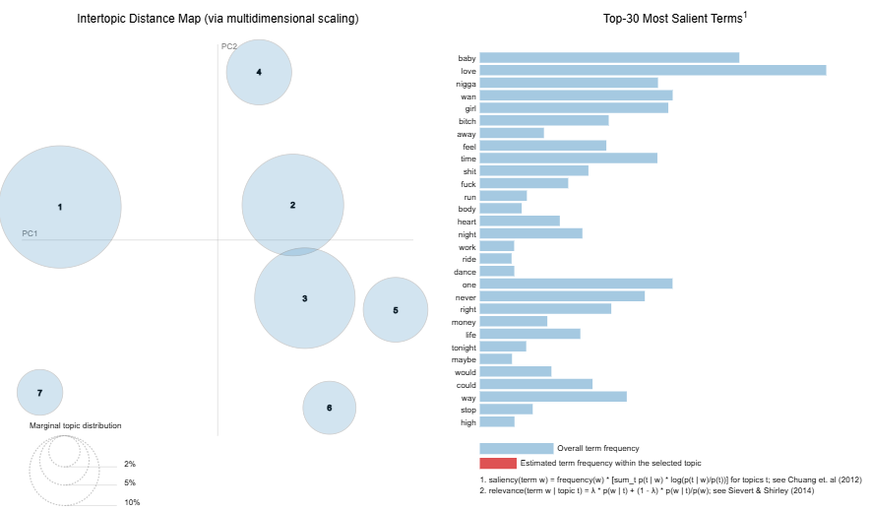

Slide 19
Topic Names & Keywords
1
Rap & Street Slang
n****, b****, s***, f***, money, back, big, hit
2
Romance & Relationships
love, time, feel, heart, life, alright, tonight
3
Life & Nostalgia
night, one, back, way, never, day, time
4
Party & Sensuality
baby, right, girl, body, dance, way, stop
5
Love & Emotion
love, girl, never, one, baby, could, tell
6
Loss & Struggle
feel, look, ride, high, look, rock, thank, fire
7
Epic Energy & Vibes
away, run, one, maybe, time, wish, would

Slide 20
Data Analysis

Slide 21
Final Dataset
5,395 songs (unique combinations of titles and artists)
Response variable: “view_count”
60 predictor variables
  23 audio features, 17 artist features
  29 dummy indicators for country, type, and genre predictors
  8 sentiment features
  5 lexical features
  7 lyrics topics

Slide 22
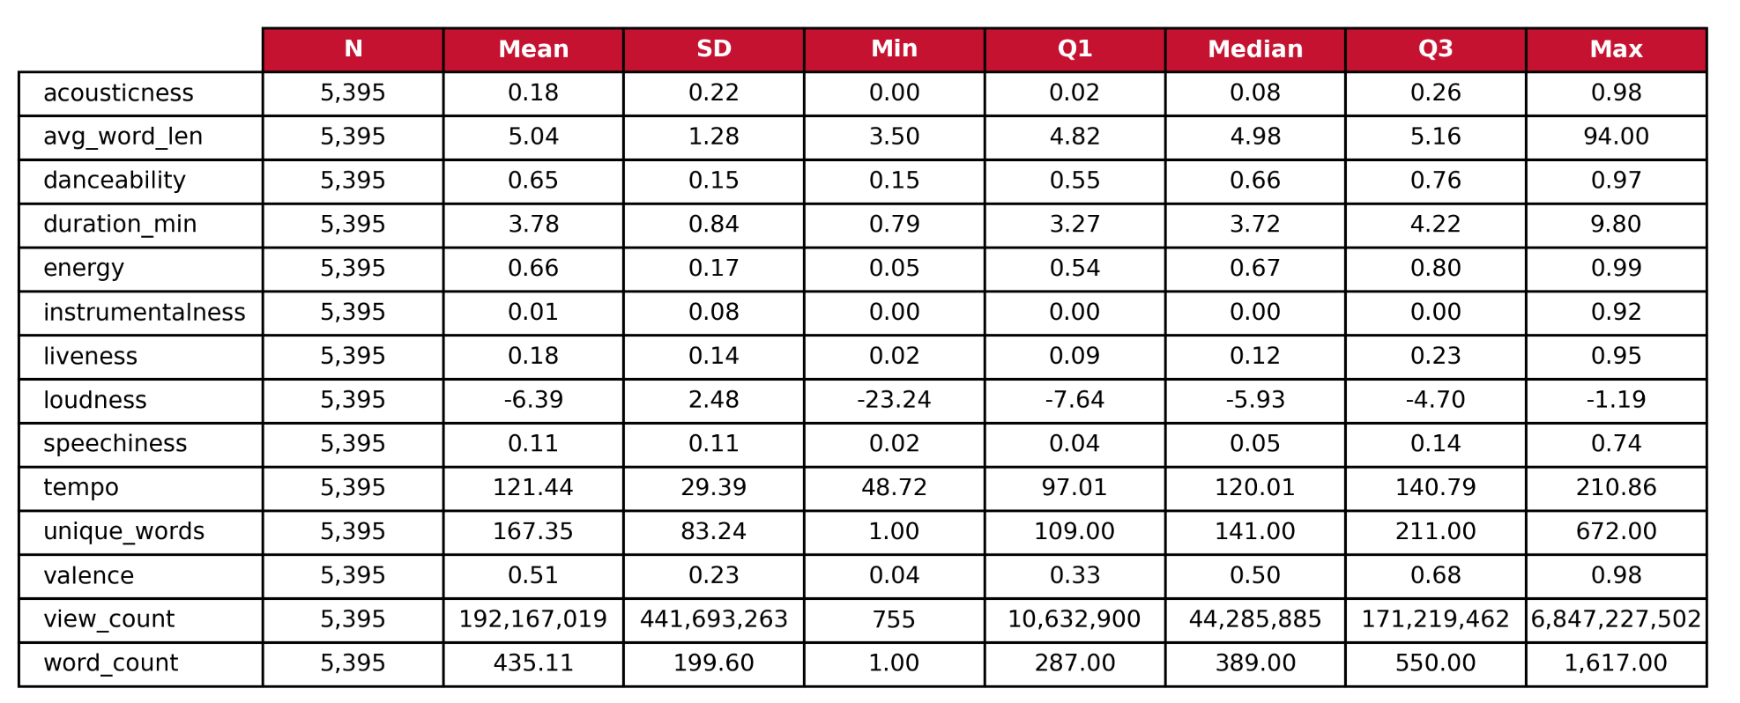
Data Summary - Audio/Lexical Features

Slide 23
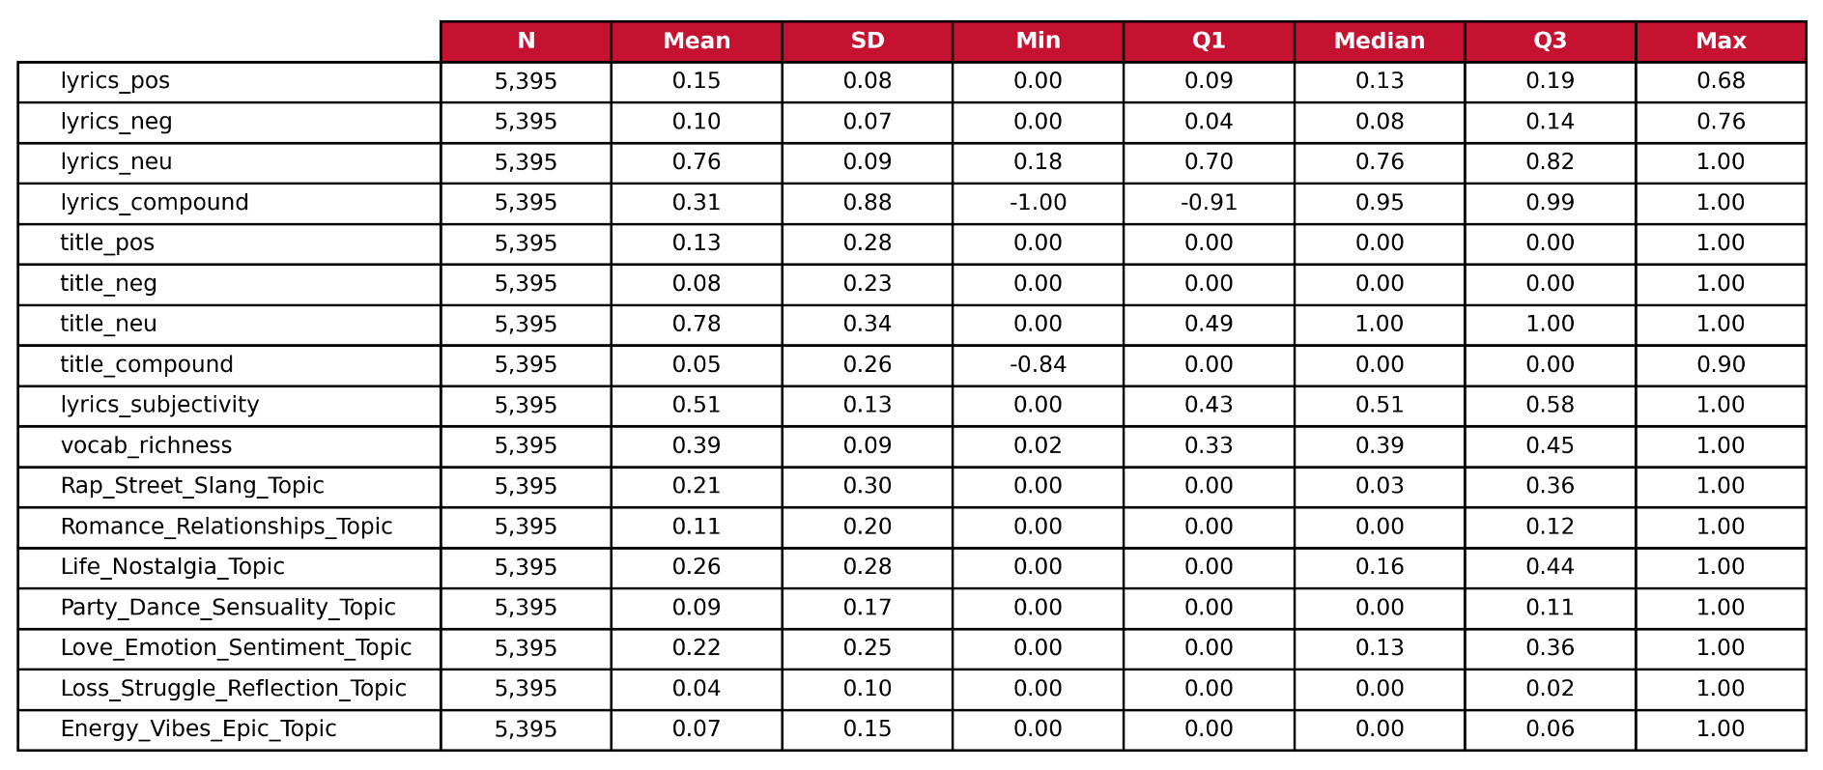
Data Summary - Text Mining Features

Slide 24
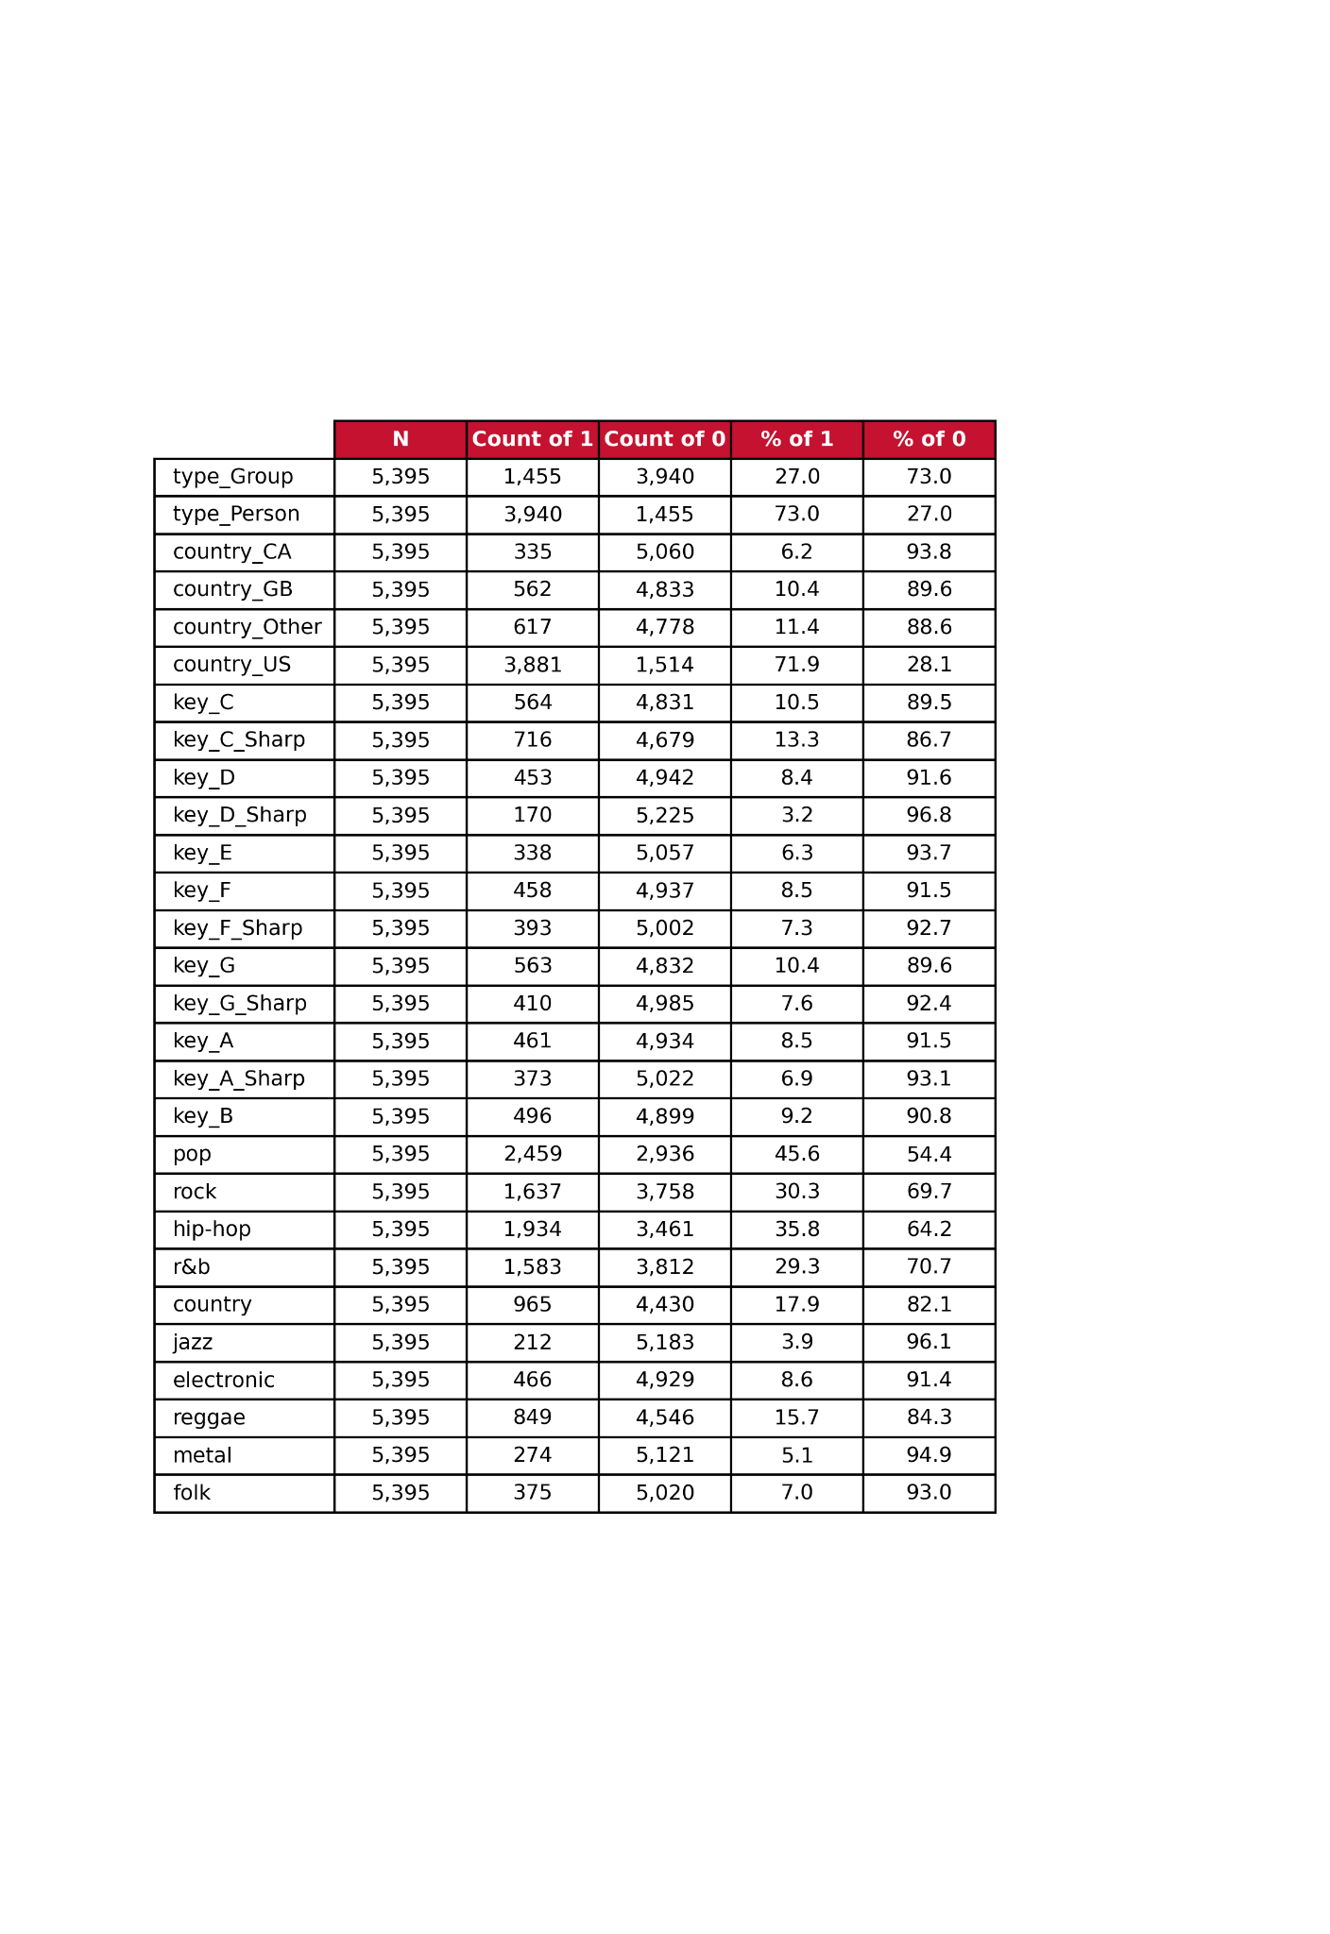
Data Summary - Binary Features

Slide 25
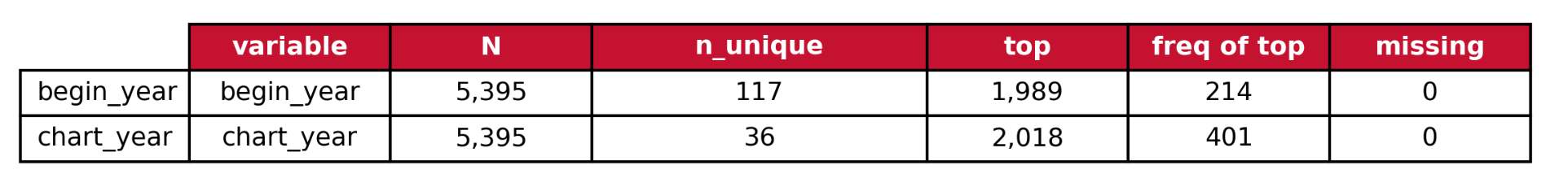
Data Summary - Discrete Features
Note: title, lyrics, and artist are not shown in this table, as there is very little repetition between observations
  For all, N = 5,395 and missing = 0

Slide 26
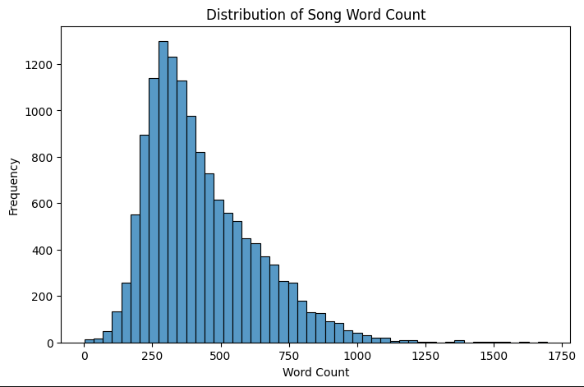
Distribution of Song Word Count

Slide 27
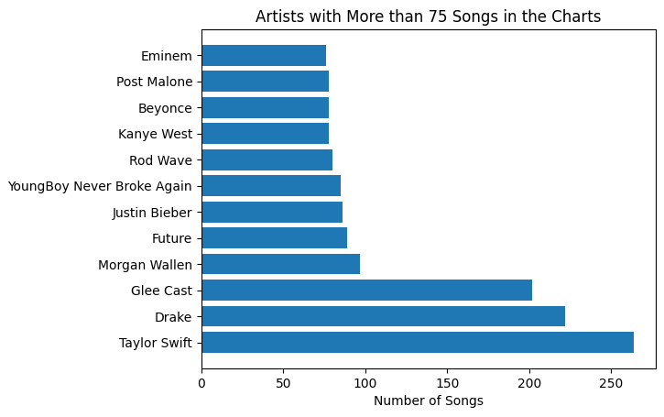
Top Song-producing Artists

Slide 28
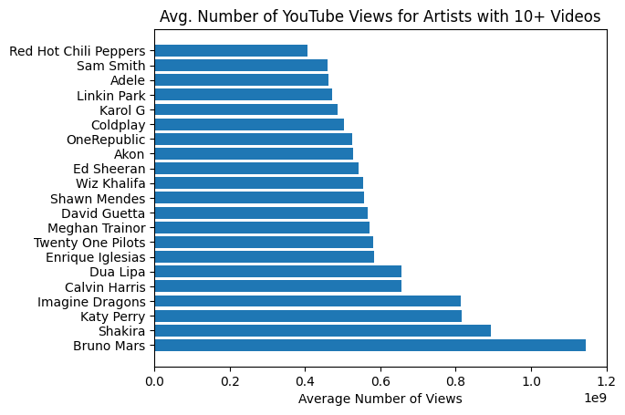
Top Artists by Average YouTube Views

Slide 29
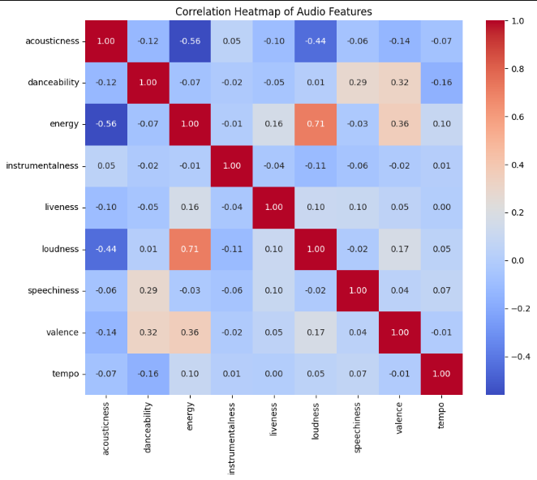
Correlation Heatmap of Audio Features

Slide 30
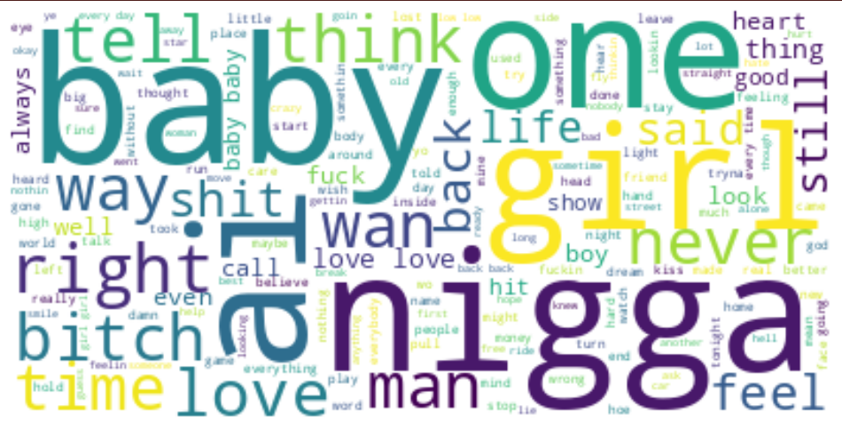
Lyrics Word Cloud
f***
s***
f*****
n****
b****

Slide 31
Model Building & Evaluation

Slide 32
Standard Practices
Split: 70% training & 30% testing
Random State: 1234
Predictors: 23 audio features, 17 artist features, 8 sentiment features, 5 lexical features, 7 lyrics topics
Cross-validation: 3 or 5 folds
Grid Search:
  Trees: criterion, max_depth, min_samples_split, n_estimators, min_samples_leaf, learning_rate, min_child_weight
  SVR: C, epsilon , gamma

Slide 33
Response
Continuous: view_count
  Number of YouTube video views for the related song
  Used for regression models
Binary: virality
  A YouTube video/song is viral if it has greater than 100,000,000 views (34.2% of songs)
  Used for classification models

Slide 34
Decision Tree Models
Regressor
Classifier
Hyperparameters
max_depth: 5
min_samples_split: 20
Mmn_samples_leaf: 5
Results
RMSE: 421,838,846
R^2: 14.8%
Response: log-transformed
Hyperparameters
criterion: gini
max_depth: 4
min_samples_split: 2
Results
Accuracy: 0.58
F1: 0.59
AUC: 0.58
Notes:
Need to speak about tuning process for both models

Slide 35
Random Forest Models
Regressor
Classifier
Hyperparameters
n_estimators: 700
max_depth: None
min_samples_leaf: 4
min_samples_split: 6
Results
RMSE: 404,674,082
R^2: 17.0%
Hyperparameters
n_estimators: 400
max_depth: None
min_samples_leaf: 2
min_samples_split: 10
Results
Accuracy: 0.65
F1: 0.62 (optimized)
AUC: 0.756
Notes:
Need to speak about tuning process for both models

Slide 36
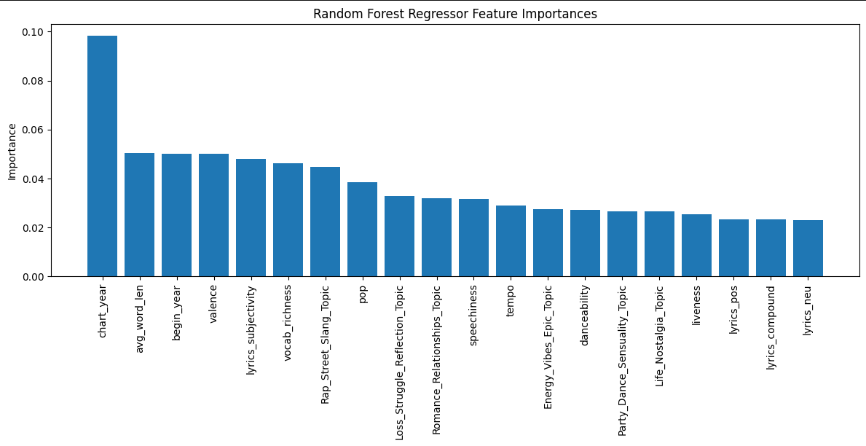

Slide 37
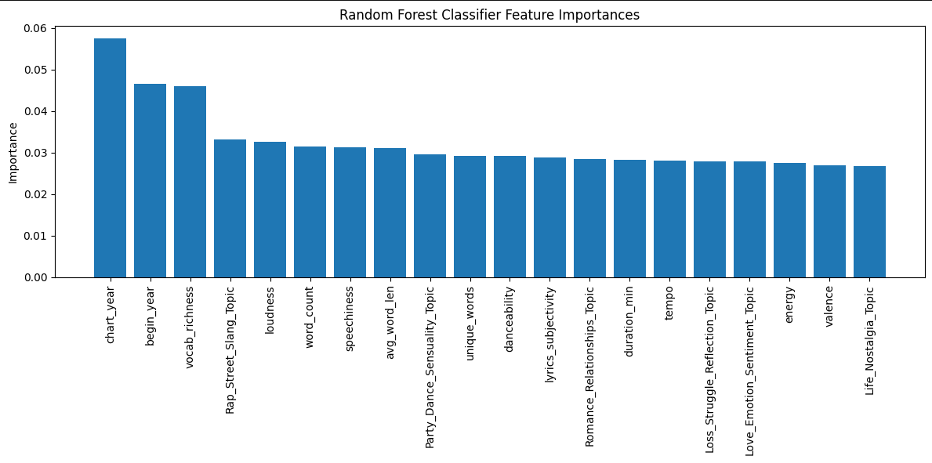

Slide 38
XGBoost Models
Regressor
Classifier
Hyperparameters
n_estimators: 300
learning_rate: 0.01
max_depth: 7
Min_child_weight: 7
Results
RMSE: 406,201,920
R^2: 14.5%
Hyperparameters
n_estimators: 400
learning_rate: 0.015
max_depth: 8
min_child_weight: 7
Results
Accuracy: 0.71
F1: 0.50
AUC: 0.75
Notes:
Need to speak about tuning process for both models

Slide 39
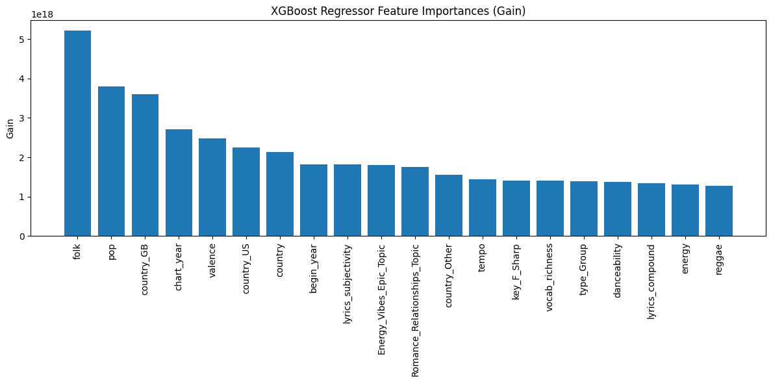

Slide 40
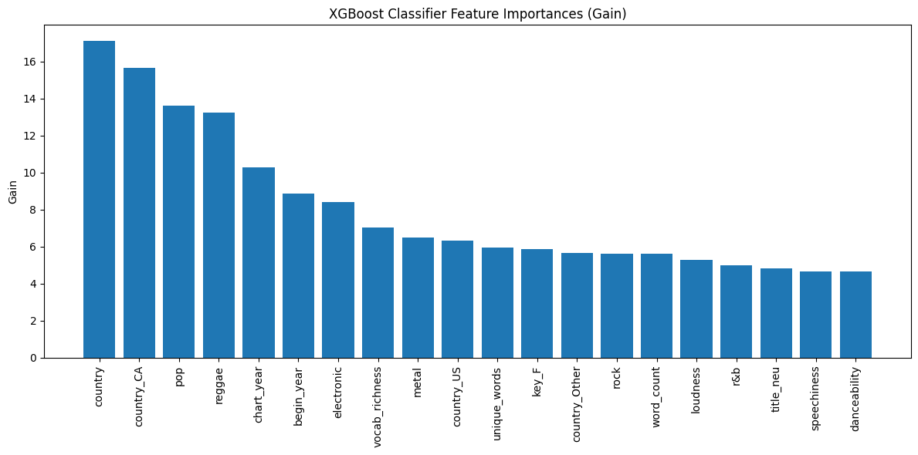

Slide 41
Support Vector Models
Regressor
Classifier
Hyperparameters
C: 100
epsilon: 0.9
gamma: 0.001
Results
RMSE: 444,915,912
R^2: 20.3%
Response: log-transformed
Hyperparameters
C: 5
gamma: 0.01
kernel: rbf
Results
Accuracy: 0.697
F1: 0.70
AUC: 0.702
Notes:
Need to speak about tuning process for both models

Slide 42
Best Model(s)
Regression
  RMSE: Random Forest (404,674,082)
  R²: Support Vector (20.3%)
Classification
  Accuracy: RF / XGB (0.71)
  F1: Support Vector (0.70)
  AUC: Random Forest (0.756)
Overall, the Random Forest Regression and Classification models were chosen as the best models in terms of minimization of error, correct classification rate, and interpretability.

Slide 43
Conclusions

Slide 44
Conclusions
R^2
Response Type
Important Predictors
Max R^2 ~ 20%, indicating the various features in the models explain little variability in view count
Predicting virality with classification models is likely more interpretable and practical for music producers/artists
There are clear factors that are important/predictive of the virality of a song. These allow us to make clear predictions.

Slide 45
Recommendations
1
Produce songs with veteran and experienced artists
2
Produce songs for reggae and pop artists over country
3
Appeal to viewers with louder, more repetitive songs
4
Restrict the use of expletives and slang to increase virality

Slide 46
Limitations
Additional Predictors
chart_year
Cultural Context
We don’t have the necessary data about the videos themselves (such as specific visual features) to fully encapsulate the predictions of the music videos’ success.
chart_year should not be used in future models as it may predict YouTube popularity instead of song popularity.
There are no predictors that indicate the cultural norms, celebrity scandals, etc. of the time period as they relate to music video views.

Slide 47
Thank you
Questions?

Slide 48
References

Slide 49
References
Araujo, C. V.S., Cristo, M. A.P., Giusti, R. (25 September, 2019). Predicting
music popularity on streaming platforms. SBC Open Lib.
https://doi.org/10.5753/sbcm.2019.10436
Dixon, S. J. (26 March, 2025). Most popular social networks worldwide
as of February 2025, by number of monthly users. Statista.
https://www.statista.com/statistics/272014/global-social-networks
-ranked-by-number-of-users/
O’Brien, C. (February 15, 2023). Case Study: How Artists and Songs Go
Viral. EDMProd.
https://www.edmprod.com/case-study-how-artists-and-songs-go-viral/

Slide 50
Appendices

Slide 51
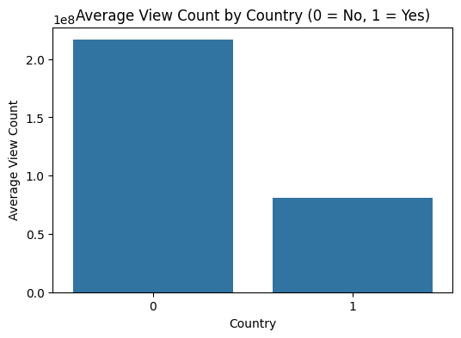
Appendix A

Slide 52
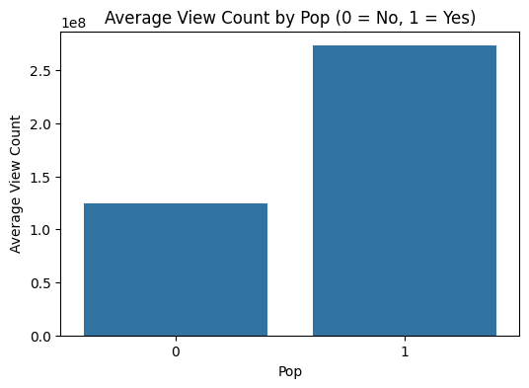
Appendix B

Slide 53
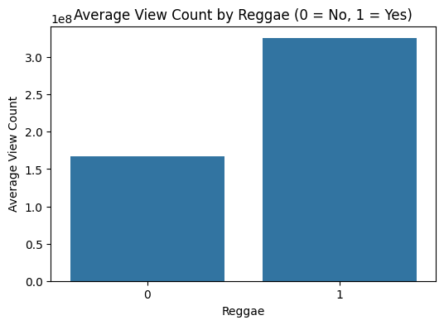
Appendix C

Slide 54
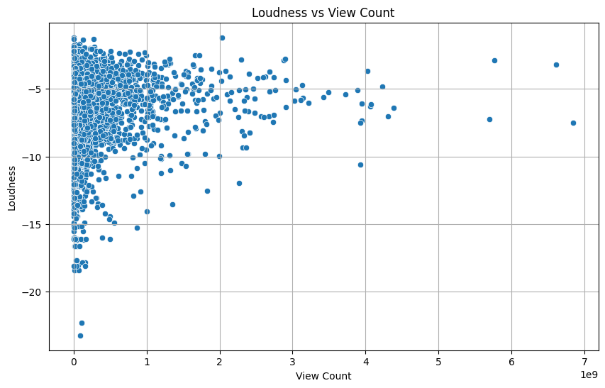
Appendix D

Slide 55
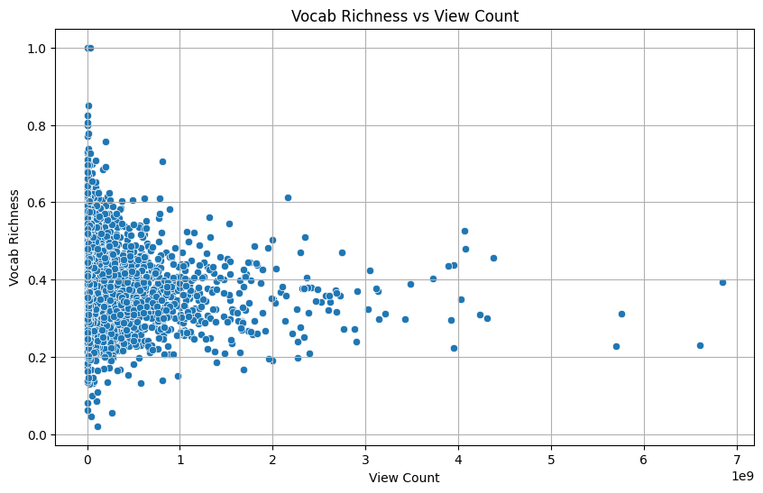
Appendix E

Slide 56
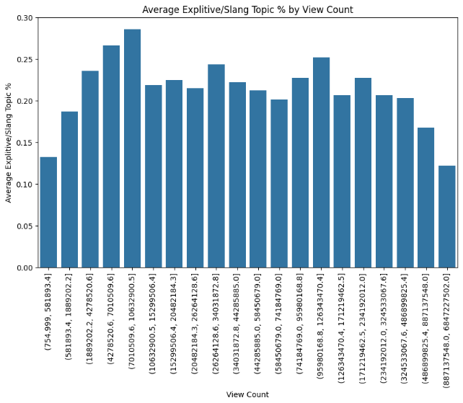
Appendix F

Slide 57
Appendix G
SVM for Regression:
Draws a line that predicts values, allowing some error within a tube, and focuses on points that are hardest to predict
SVM for Classification:
Draws a line that separates two classes, keeping line as far from the nearest points as possible
Hyperparameters:
C: Regularization parameter
Kernel: Determines transformation of input variables for hyperplane
Gamma: Controls influence of a single data point (rbf kernel only)
Epsilon: Width of tube around predicted line (SVR only)

